Slide 1
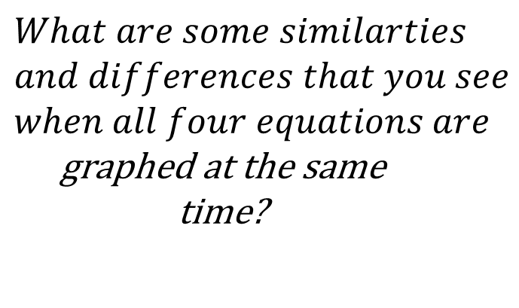
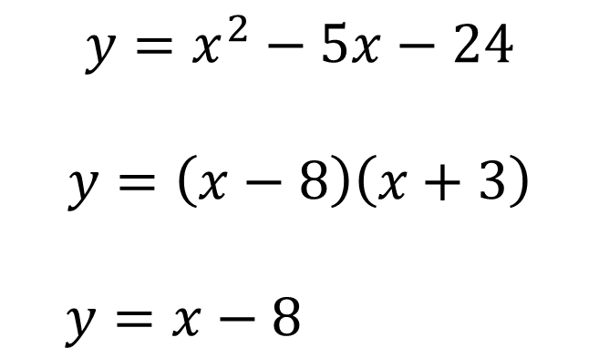

Bell Work Graph the following:
$$y=x^{2}−5x−24$$
$$y=\left(x−8\right)\left(x+3\right)$$ $$y=x−8$$
$$y=x+3$$
$$What are some similarties$$
$$and differences that you see$$
$when all four equations are$ graphed at the same time?
$$y=x+3$$

Slide 2
ALGEBRA 3
Day 6

Slide 3
Chapter 1 Section 2 Properties of Real Numbers
Objective: To classify, graph, and become familiar with the types of real numbers

Slide 4
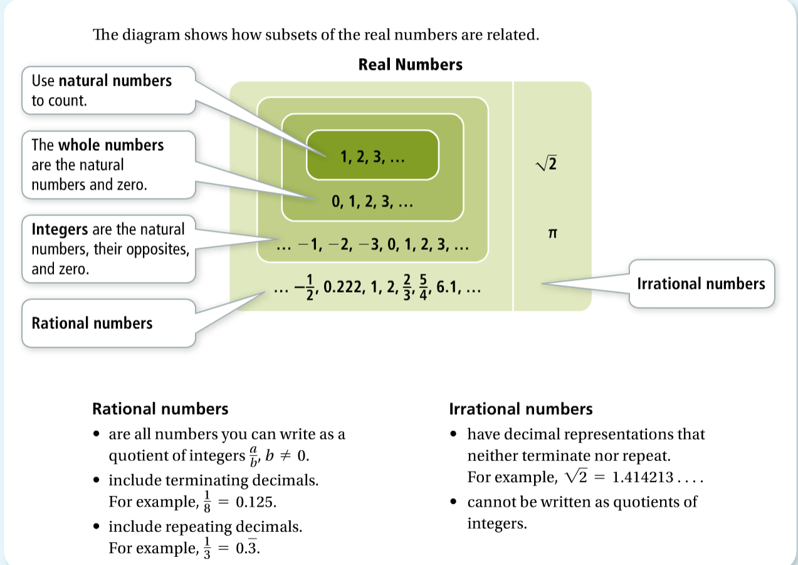

Slide 5
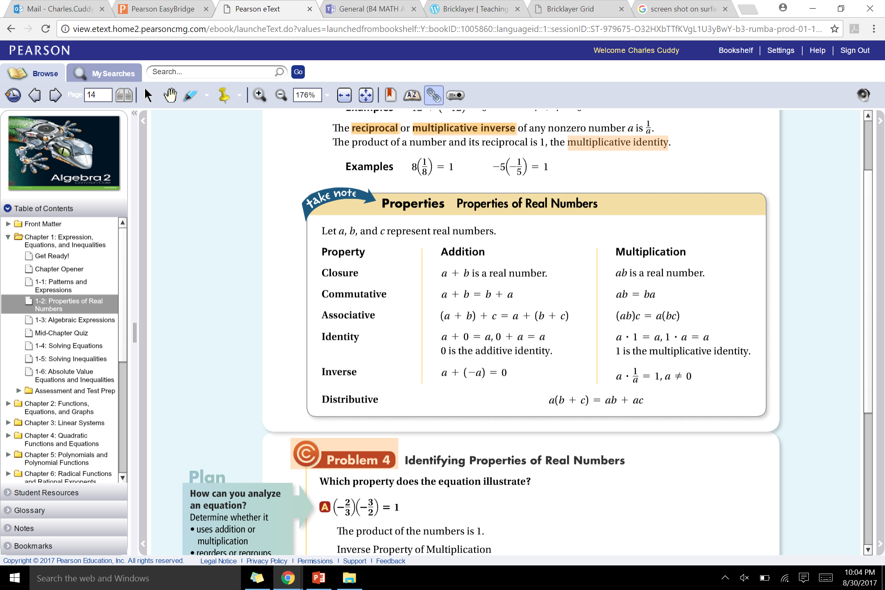

Slide 6
Review: Using the Online Text Book and Teams
Log into your Office 365 account
Click on the Waffle
Click “All”
Search “Pearson”
Select our class and open the book
■ Online Discussion
■ Notes and PowerPoints

Slide 7
For Next Time…
From Today:
Page 15 #1-3, 13-22 (on same number line), 50, 66
Mixed Review:
Page 17 #75, 80, 81, 82

